Slide 2
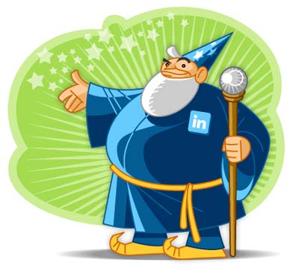
"Using LinkedIn Strategically to Win the Gold"
Notes:
Bring articles & events list & meetup list
Update my profile
Mock pitches
Homework
Slide 11 success story
Bring What do you want to learn about today?
Thanks for inviting me.
In the past 14 years my teams and I have probably hired close to 10,000 people. Honestly, if I knew then what I know now, I would have been even more effective in my job.
Stacey invited me to talk to you today because of late I’ve become a networking guru in NJ and LinkediN has helped with that process.
Karen knows me from back in the Kaplan days when I was her Senior Director of Recruiting & Career Development. In the past 13 years my teams and I have probably hired close to 10,000 people. Honestly, if I knew then what I know now, I would have been even more effective in my job.
Karen invited me to talk to you today because of late I’ve become a networking guru in NJ. In the past few months I have developed new relationships with hundreds of people all through networking.
How would you like to meet 50 new people every month. Do you think that would help ADVHR’s biz grow? Do you think it would help you fill positions? Today I’m going to show you how.

Slide 3
Who is this Abby person and why is she just like me?
Notes:
Our topic today is The Top Interview Questions Exposed
Interviewing is just like ice skating. It takes practice. Sometimes you glide along nicely and sometimes you stumble and fall. The problem is that most of the time, you don't know why you fell because no one will tell you.
But because I'm Absolutely Abby I tell you things that other recruiters won't tell you. In this teleseminar, you'll learn what is really inside the head of a corporate recruiter or HR professional when they ask you the interview "stumpers". You'll also learn how to avoid the "gotchas“.

Slide 4
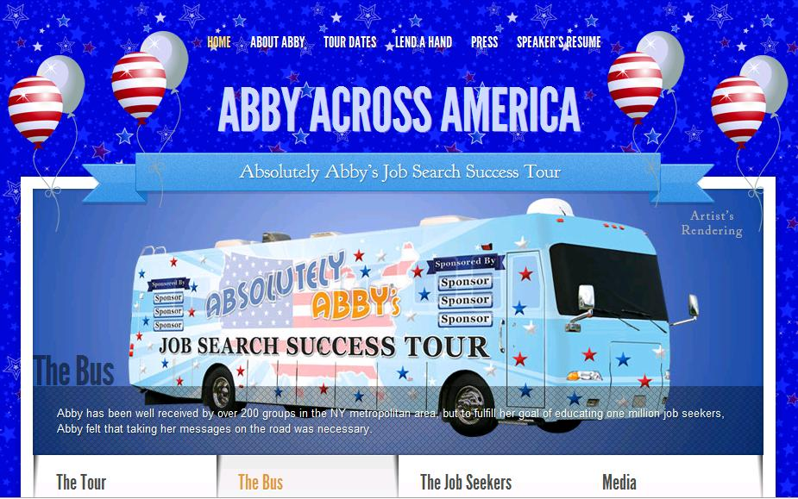

Slide 5
“RELATIONSHIPS MATTER”
830 million members since 2003
Six new people join LinkedIn every day
1 million Recruiters are using LinkedIn
6 people get hired on LinkedIn every minute
87% of the recruiters surveyed say they use LinkedIn to recruit
It’s FREE!!!
Notes:
5
5
My Space for grownups
Monster = $300 or $10,000
HR can do what headhunters can do

Slide 6
“RELATIONSHIPS MATTER”
How Recruiters Find You
How You Can Find Them
Having a Current Job or Not
Searching for Hiring Managers
Endorsements & Recommendations
Upgrading Your Visibility
Paying For LinkedIn
Settings and Privacy
LinkedIn Job Search Tools
Getting the Slides
Notes:
6
6
My Space for grownups
Monster = $300 or $10,000
HR can do what headhunters can do

Slide 7
What’s the LinkedIn Algorithm to Help Me Become A Magnet For Recruiters?

Slide 8
How Recruiters Find You

Slide 9
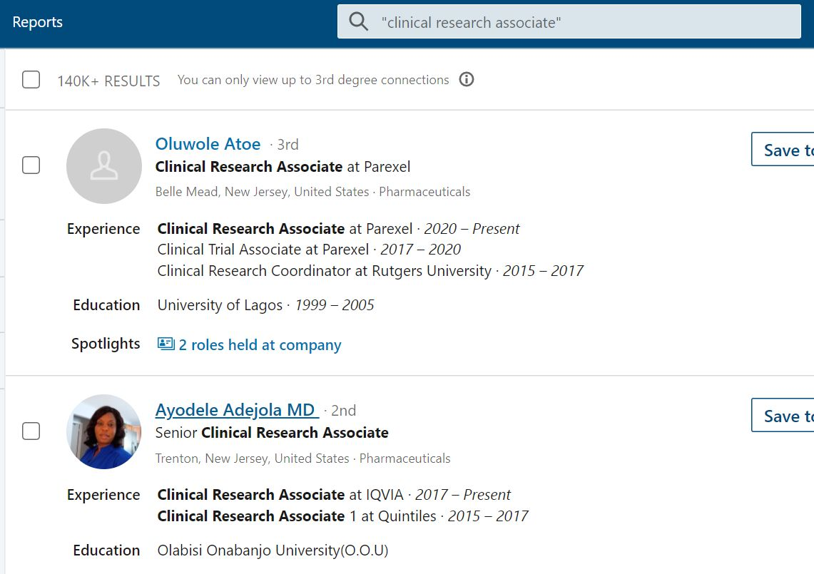

Slide 10
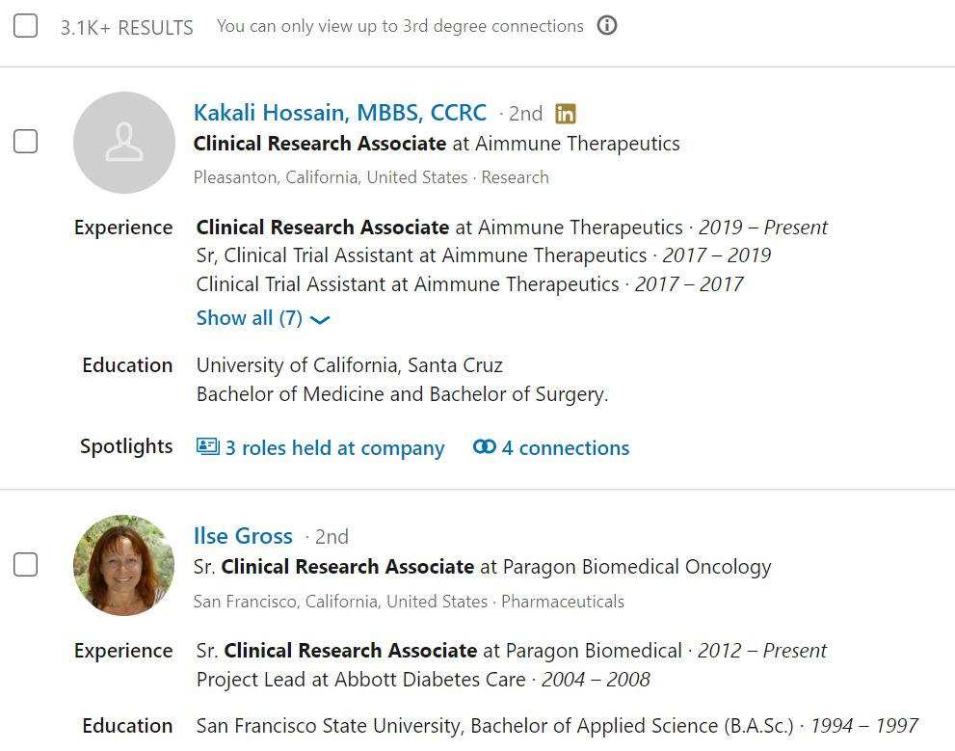

Slide 11
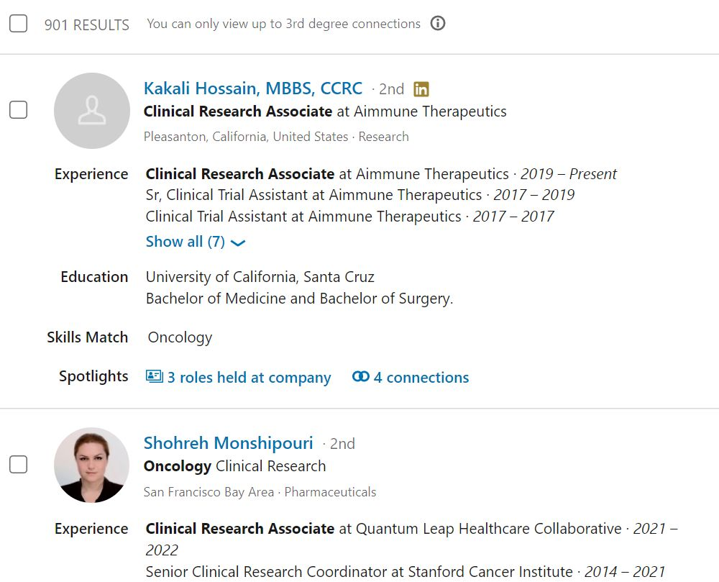

Slide 12
Copy Your Resume Into Your Profile

Slide 13
Keywords are Key

Slide 14
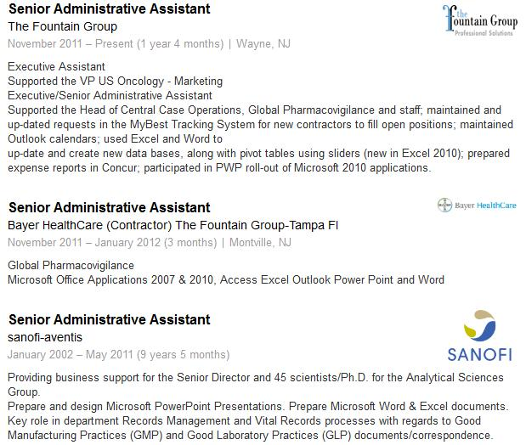
The Keys to Your Success
Notes:
Spell checking
Mgr
Certifs

Slide 15
Email, Phone & Remote?

Slide 16
Having a
“Current” Job

Slide 17
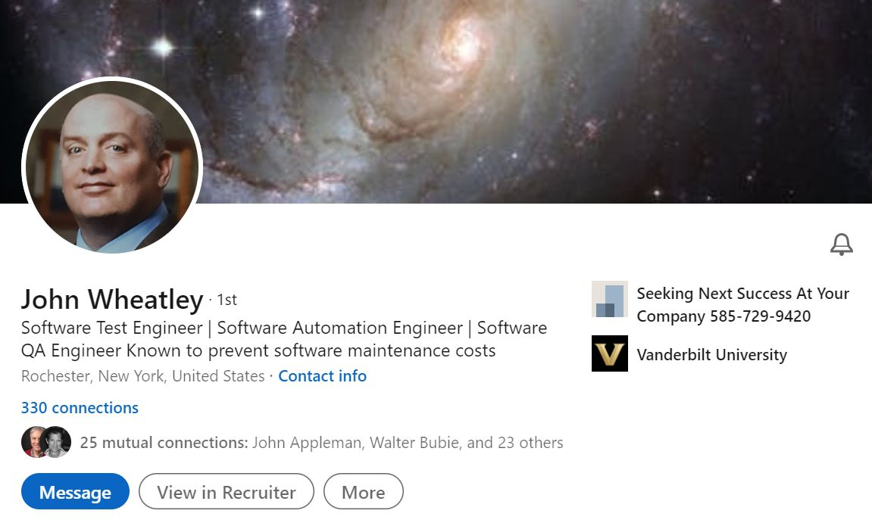

Slide 18
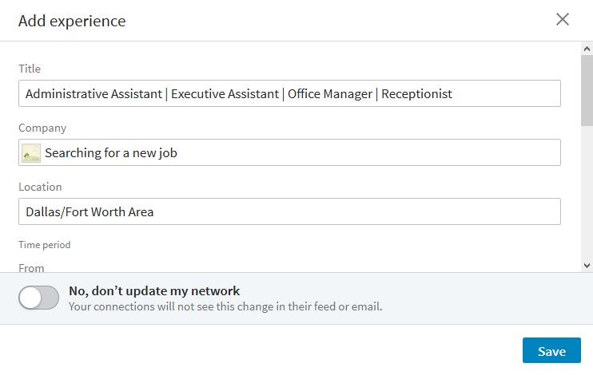
Creating a Current Experience

Slide 19
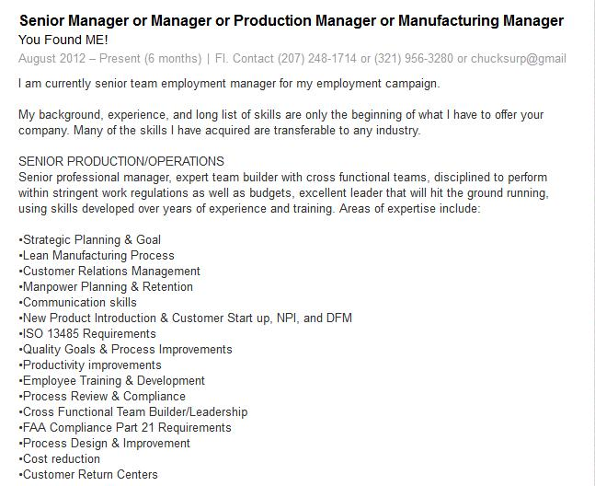
Notes:
Likes LinkedIn is your story
Recruiters use job boards
Talk a lot about CIG
LinkedIn is a marketing tool

Slide 20
Additional
Profile Possibilities

Slide 21
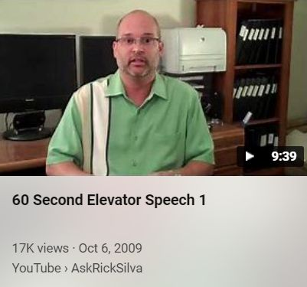

Slide 22
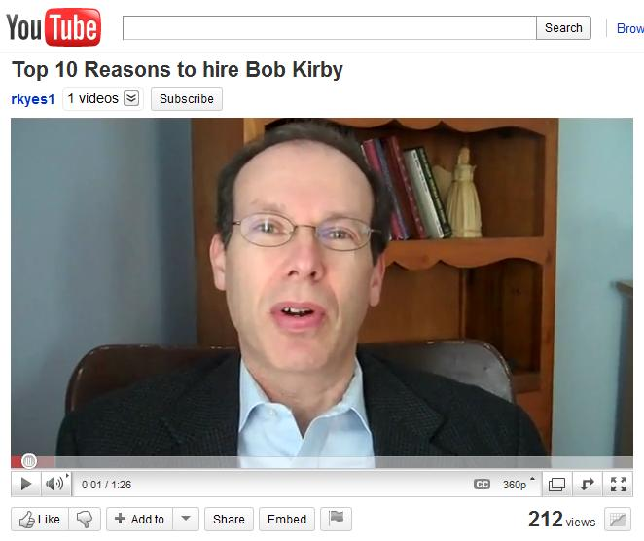

Slide 23
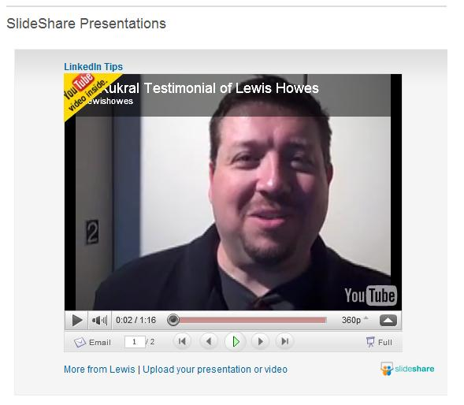

Slide 24
Skills, Endorsements &
Recommendations

Slide 25
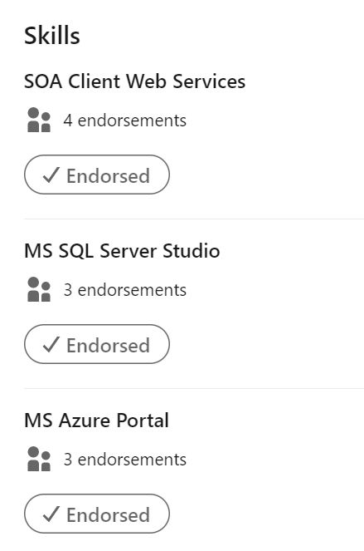
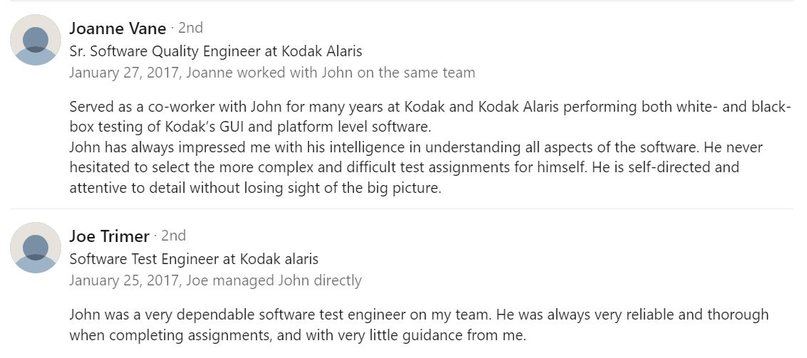

Slide 26
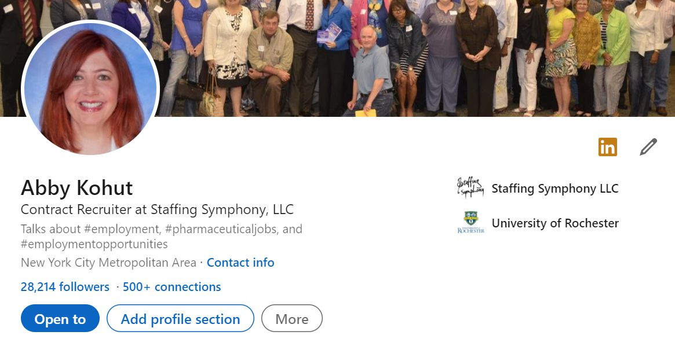
Adding a Profile Section

Slide 27
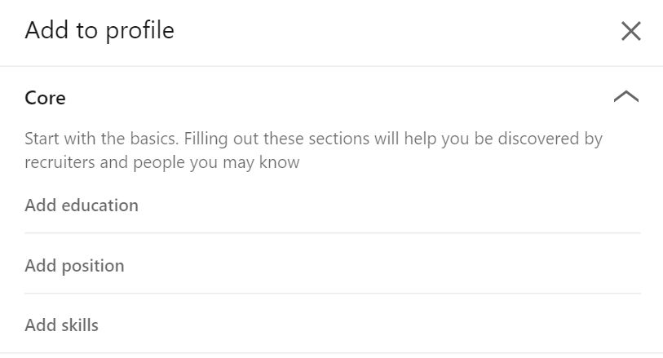
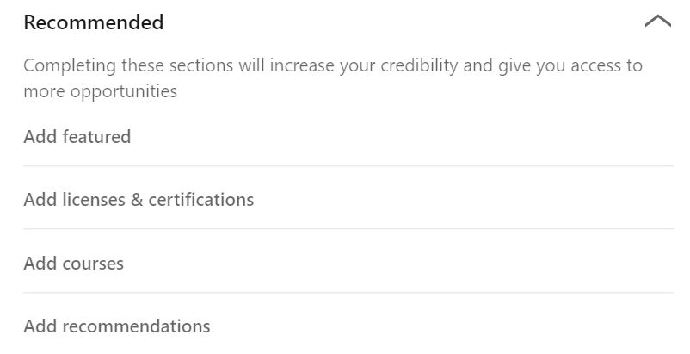
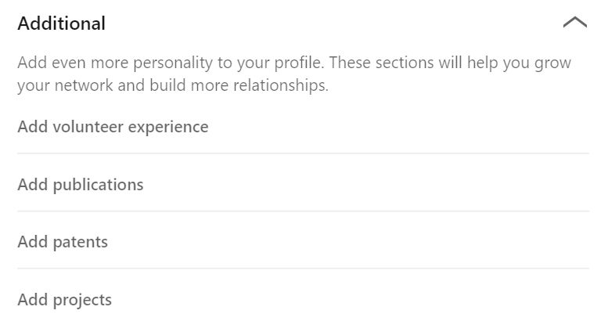

Slide 28
Your URL & Public Profile

Slide 29
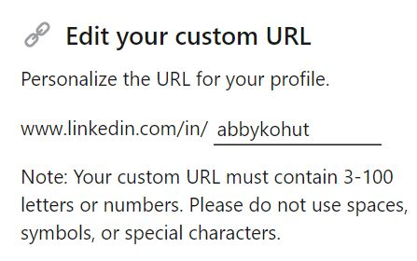
Your New Personal URL
Abby Kohut
Contract Recruiter
Abby@AbbyKohut.com
www.linkedin.com/in/abbykohut

Slide 30
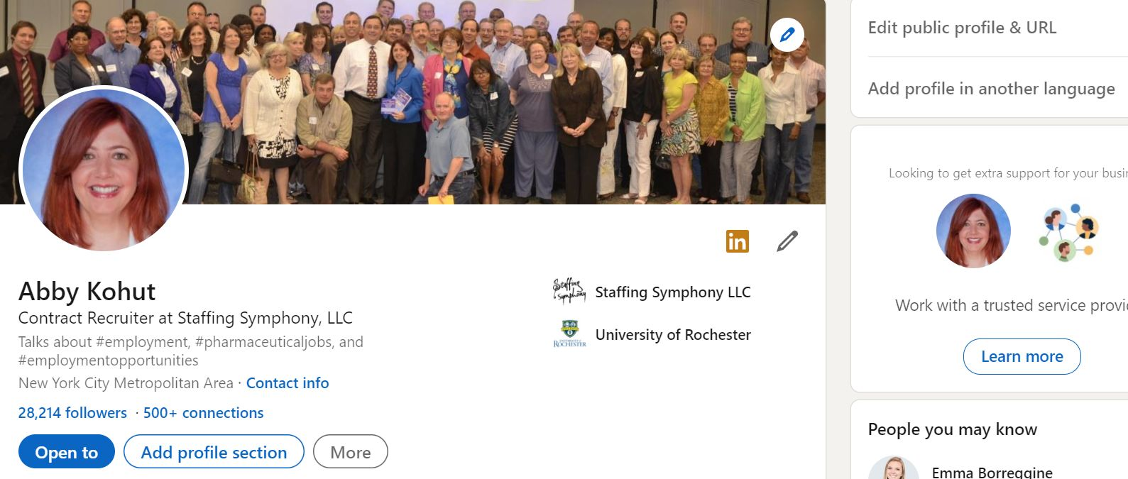
Editing Your Public Profile & URL

Slide 31
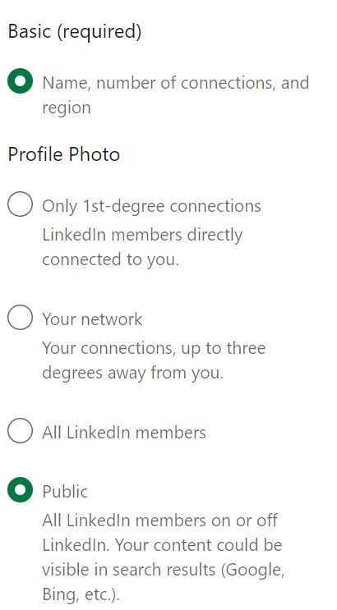
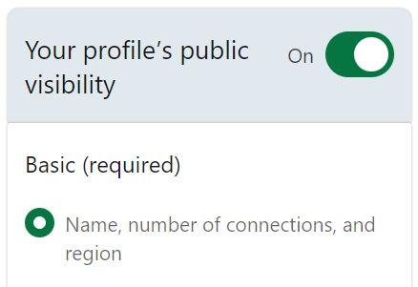

Slide 32
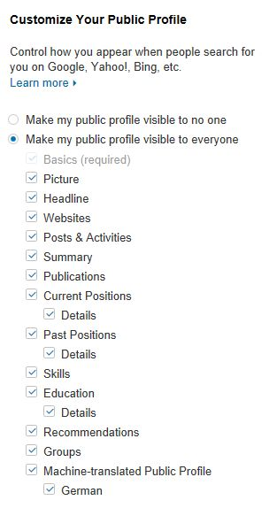

Slide 33
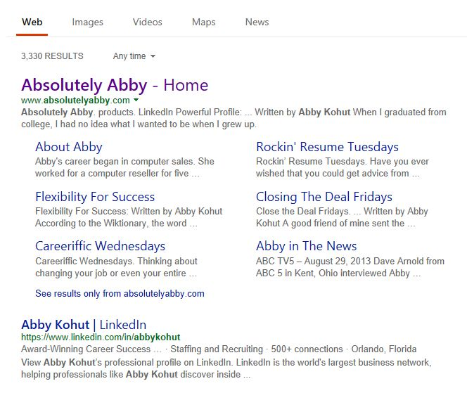

Slide 34
To Pay or Not To Pay

Slide 35
LinkedIn Basic vs. LinkedIn Premium
LinkedIn Basic
LinkedIn Premium (Job Seeker)
Free to all users
Can see the last 5 views of your profile
Can’t send InMails
Fewer search filters
Premium Career account holders are hired an average of two times as fast as other candidates
Free Trial
Costs $39 per month
Can see people who have viewed your profile over the last 90 days
Can see how those people arrived at your profile
Can send 5 InMails per month
More profile views

Slide 36
Searching for Hiring Managers

Slide 37
“ ”s are your and my BFFs

Slide 39
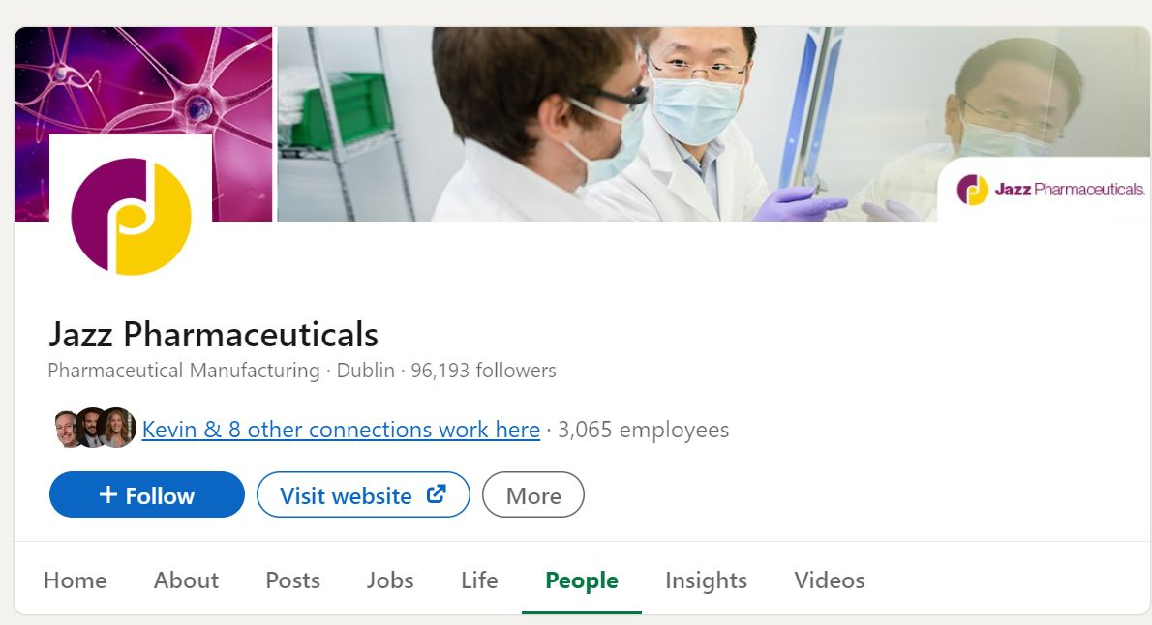

Slide 40
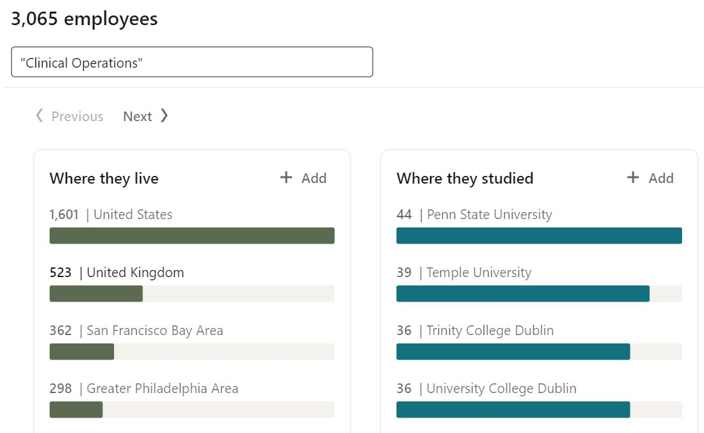

Slide 41
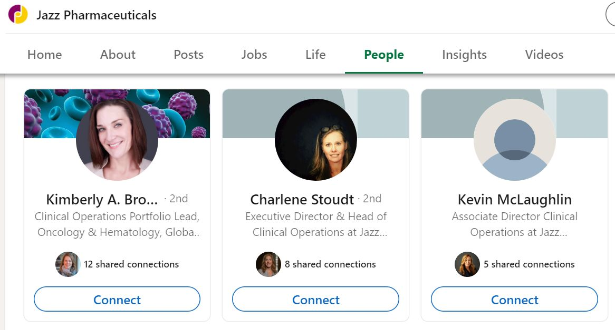

Slide 42
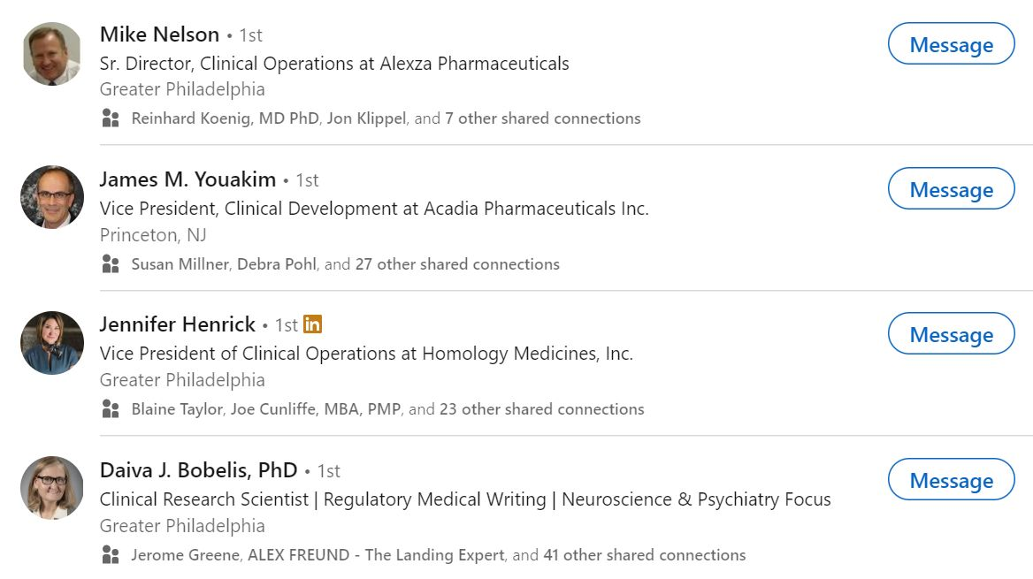

Slide 43
Customizing
Connection Requests

Slide 44
Finding Search Firms

Slide 45
“ ”s are our new BFFs

Slide 46
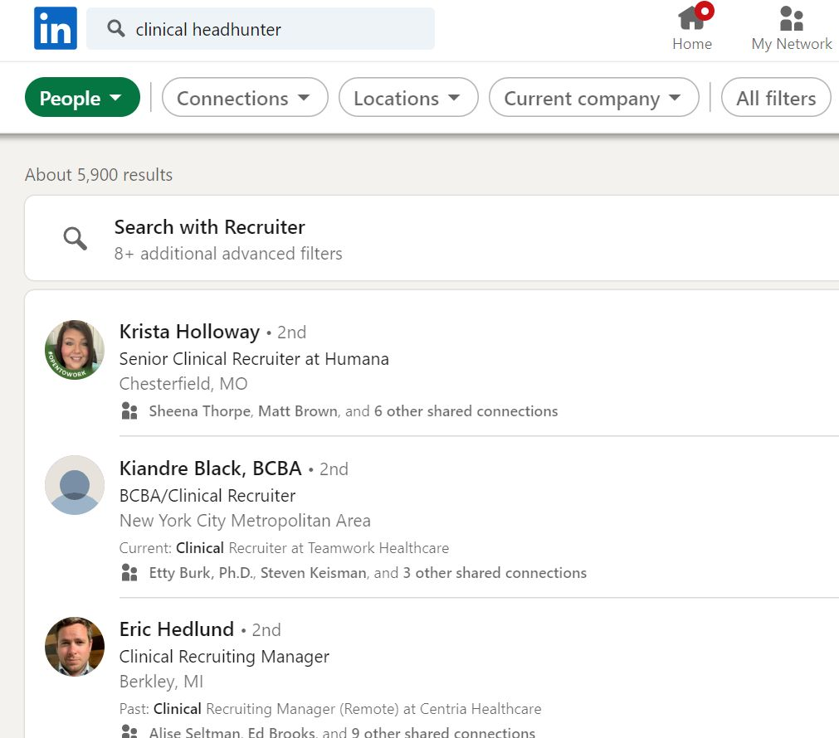

Slide 47
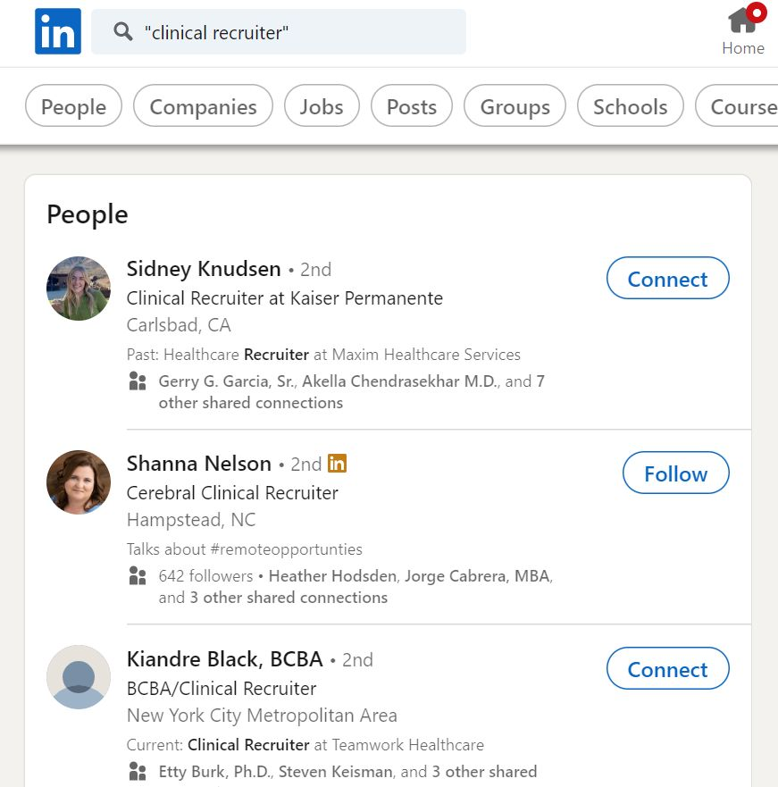

Slide 48
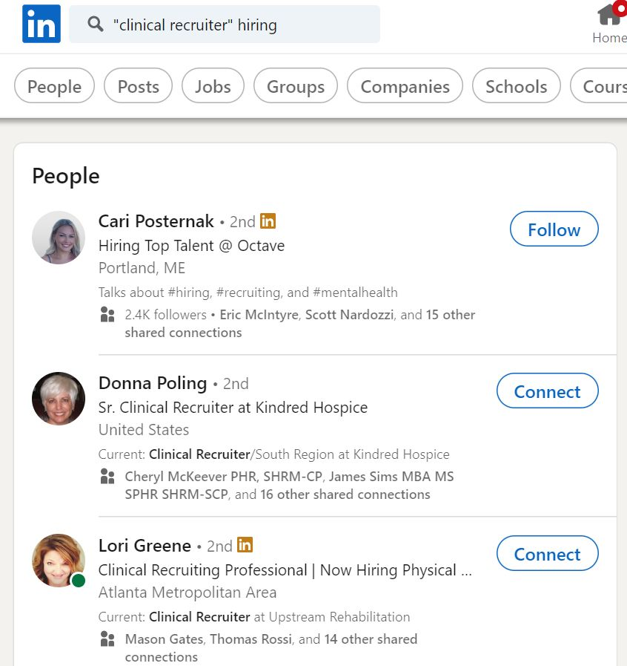

Slide 49
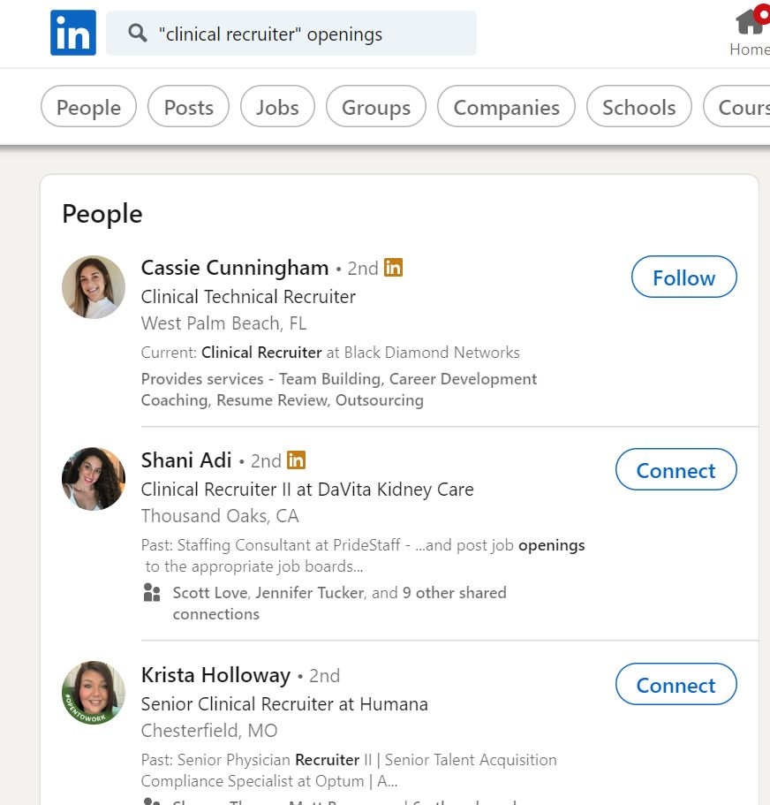

Slide 50
Customizing
Connection Requests

Slide 51
StaffingSymphony.com

Slide 52
Job Search Tools

Slide 53
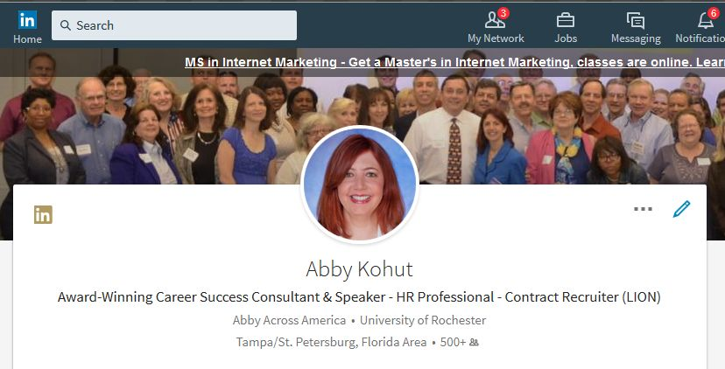

Slide 54
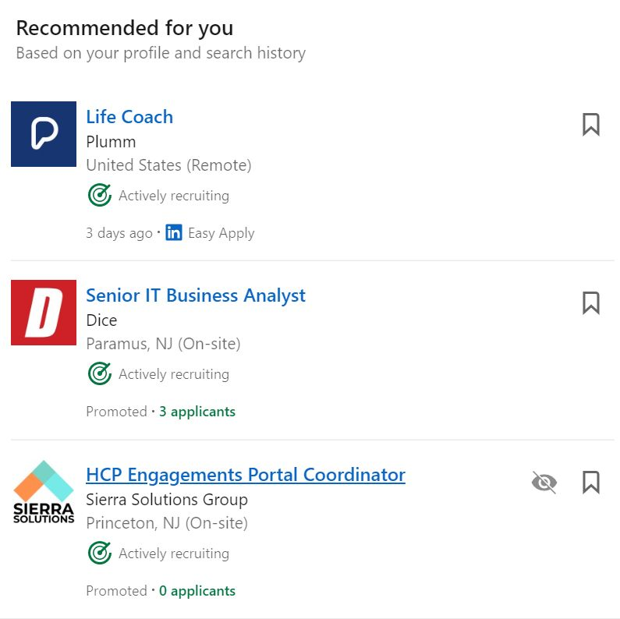
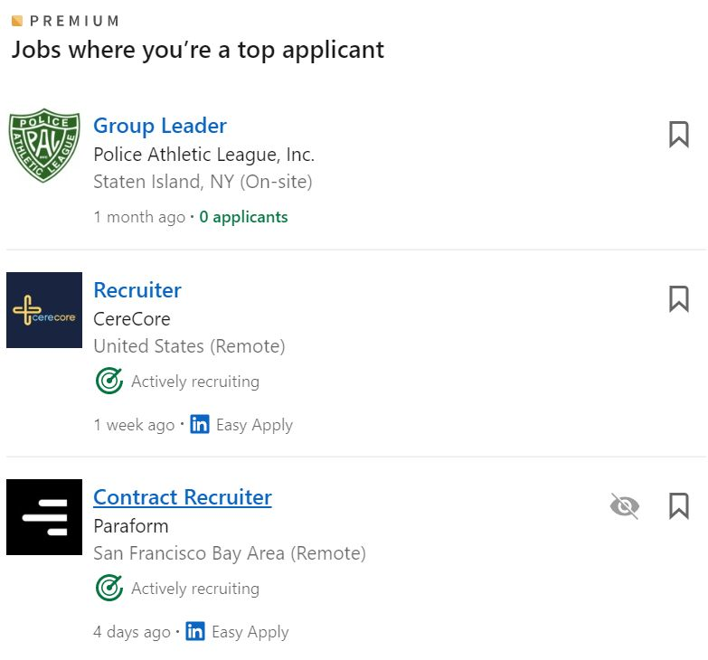

Slide 55
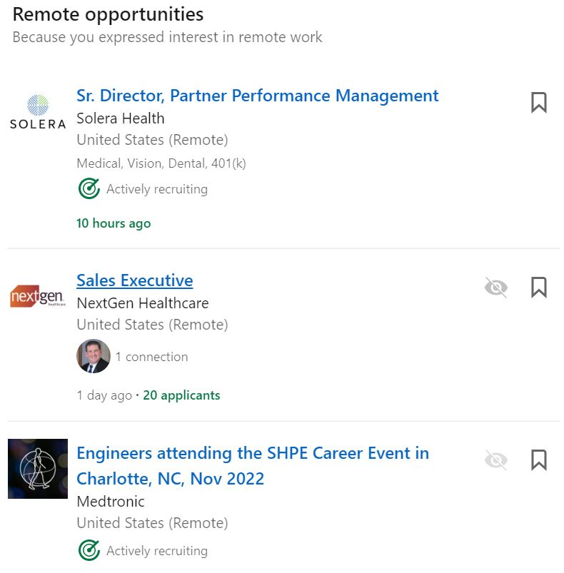
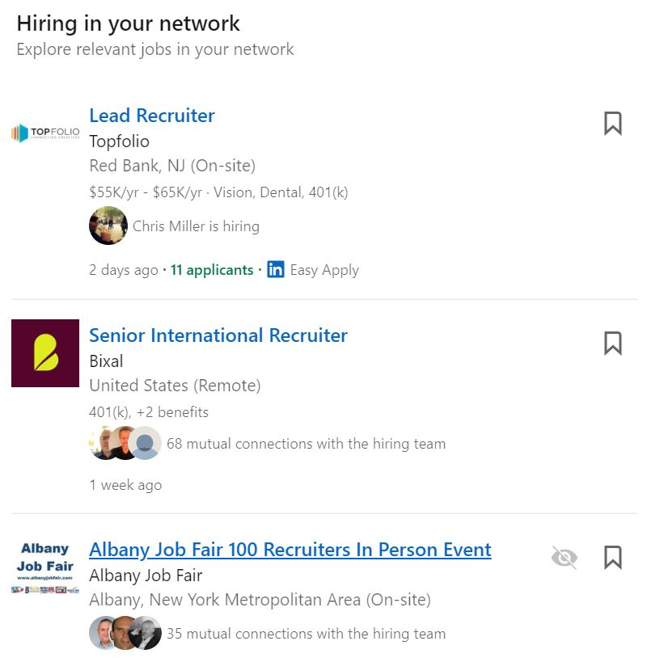

Slide 56
LinkedIn Premium
for Job Seekers

Slide 57
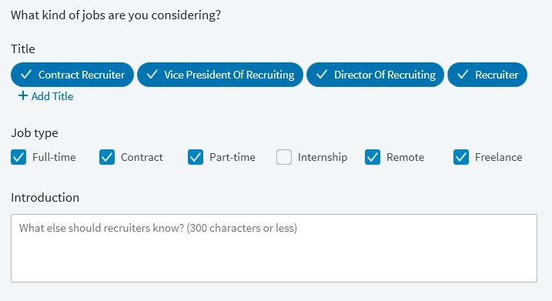

Slide 58
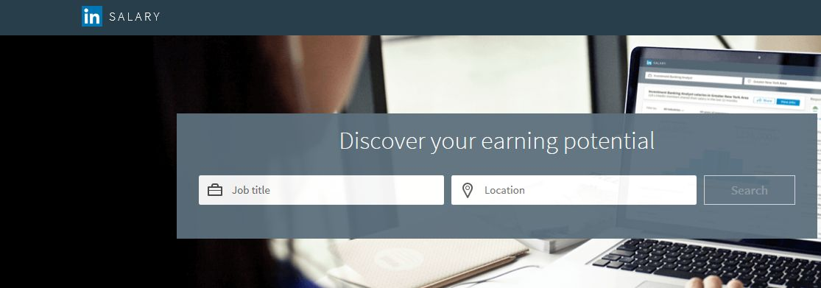

Slide 59
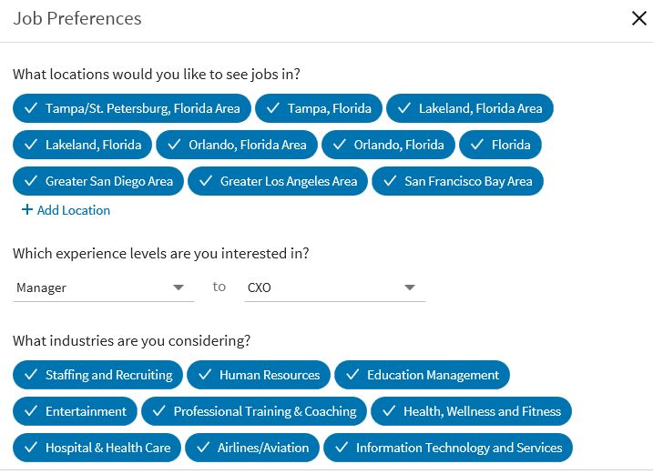

Slide 60
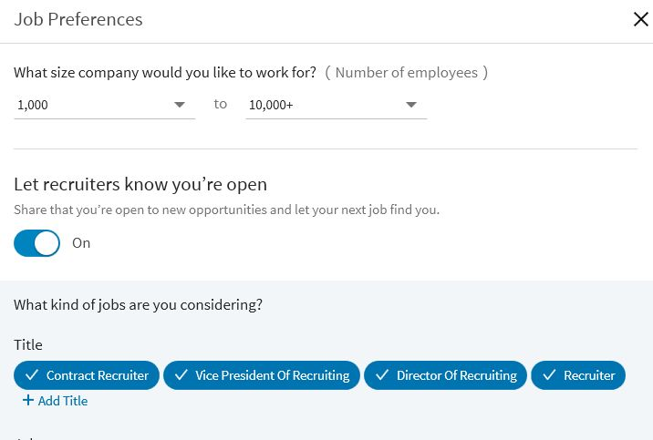

Slide 61
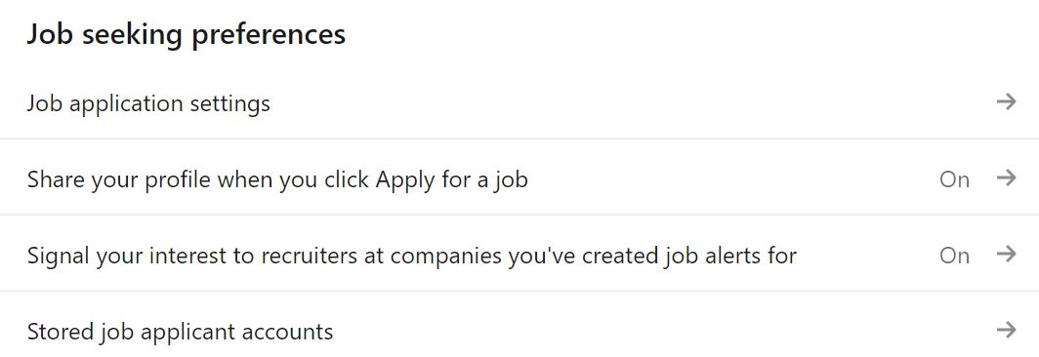

Slide 62
The Open to Work Badge

Slide 63
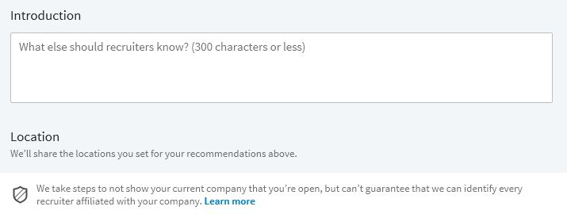
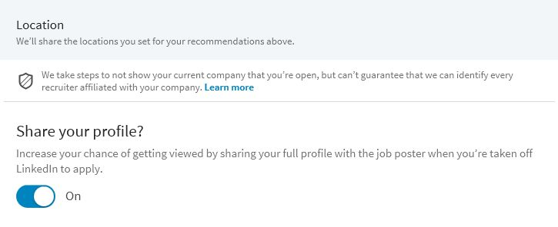

Slide 64
Fun on the Home Page

Slide 65
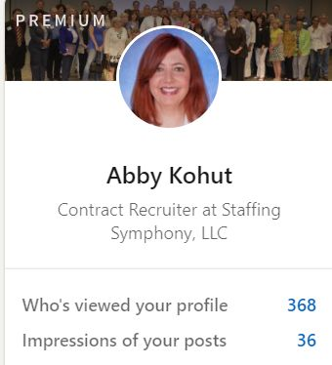
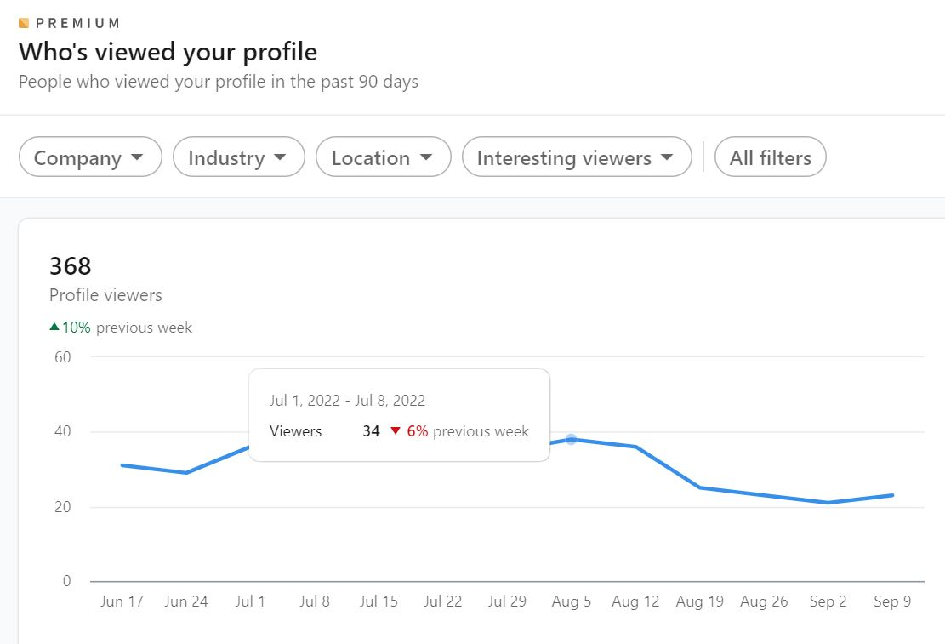

Slide 66
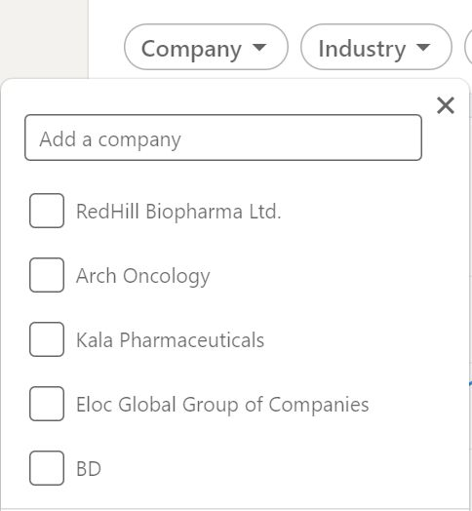

Slide 67
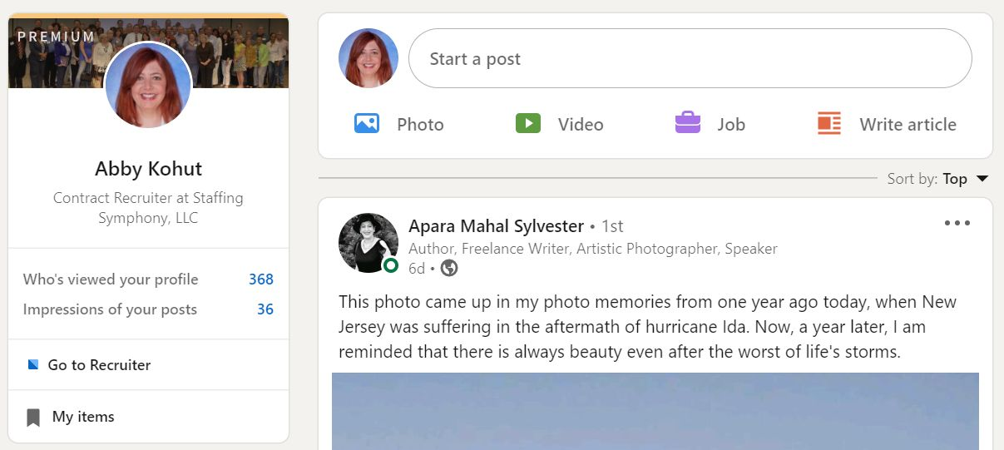
Update Your Network

Slide 68
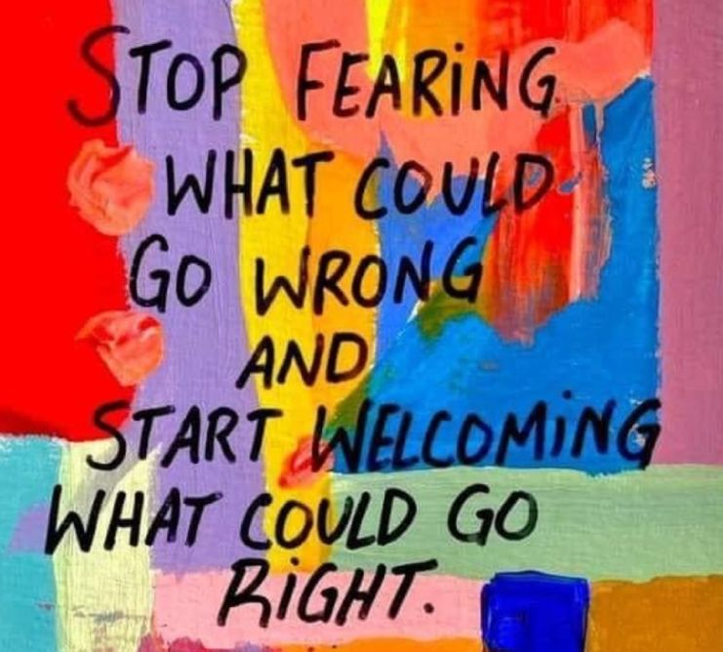

Slide 70
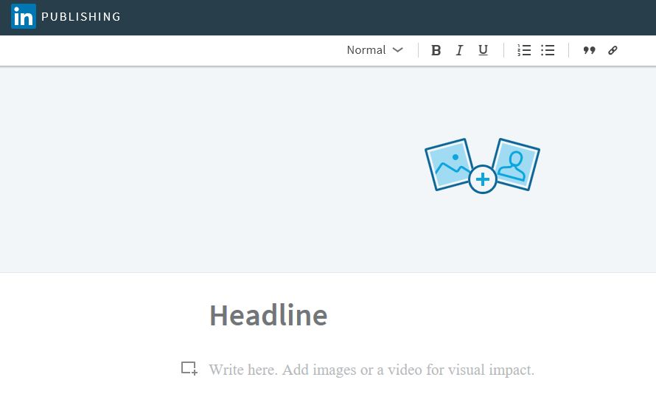

Slide 71
Account & Privacy Settings

Slide 77
How to Interview Like a Rockstar Thursday 9/15 at 4:00 PM EST
Job Search
Do’s and Don’ts
Friday 9/20 at 7:00 PM EST
Notes:
Our topic today is The Top Interview Questions Exposed
Interviewing is just like ice skating. It takes practice. Sometimes you glide along nicely and sometimes you stumble and fall. The problem is that most of the time, you don't know why you fell because no one will tell you.
But because I'm Absolutely Abby I tell you things that other recruiters won't tell you. In this teleseminar, you'll learn what is really inside the head of a corporate recruiter or HR professional when they ask you the interview "stumpers". You'll also learn how to avoid the "gotchas“.

Slide 78
Got Questions?
Abby Kohut
www.StaffingSymphony.com
StaffingSymphony.com/Arch
Join me on LinkedIn!
Notes:
78

