Slide 1
"First Workforce Ghosting, to Workforce Pandemic, and now Job Masking: Where are the job seekers hiding and how to bring them back into the workforce?“
California Placement Association:
Connecting Tomorrow’s Leaders Monthly Webinars
Presentation and roundtable discussion with workforce and employer experts
Jackie Kennedy Harris, JKH Career Coaching & Consulting
&
Rosalinda Rivas, President, California Placement Association
November 3, 2021

Slide 2
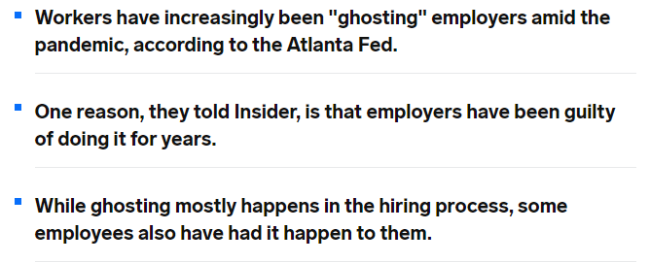
California Placement Association:
Connecting Tomorrow’s Leaders Monthly Webinars
Workforce Ghosting
https://www.esrcheck.com/wordpress/ https://www.businessinsider.com/workers-say-employers-managers-guilty-of-ghosting-job-applicants-employees-2021-9
Jackie Kennedy Harris, JKH Career Coaching & Consulting
&
Rosalinda Rivas, President, California Placement Association
November 3, 2021

Slide 3
A record-high 4.3 million workers in the United States quit their jobs the “Great Resignation” in August 2021, according to the Job Openings and Labor Turnover Survey (JOLTS) report released by the U.S. Bureau of Labor Statistics, which represents the highest monthly total since the data series began in December 2000.
California Placement Association:
Connecting Tomorrow’s Leaders Monthly Webinars
The Great Resignation
https://www.esrcheck.com/wordpress/2021/10/13/4-3-million-workers-quit-jobs-august-2021/
Jackie Kennedy Harris, JKH Career Coaching & Consulting
&
Rosalinda Rivas, President, California Placement Association
November 3, 2021

Slide 4
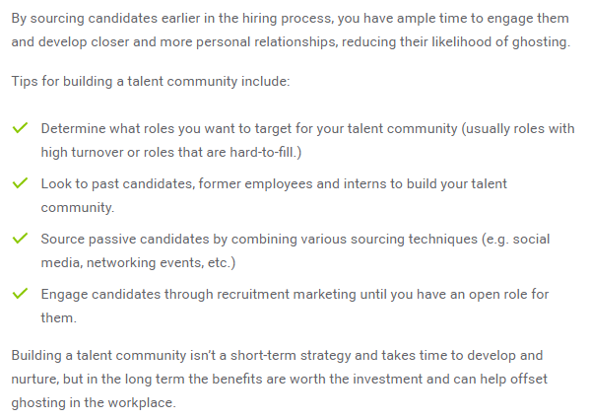
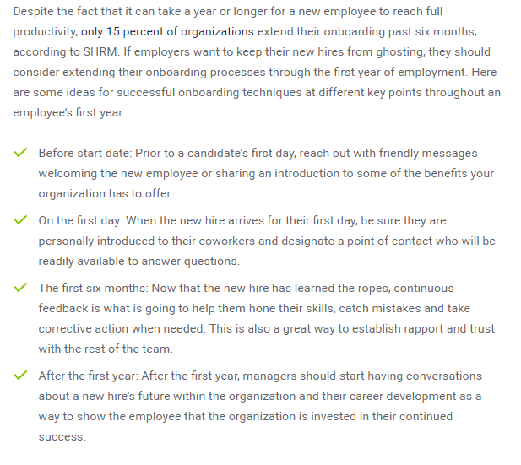
California Placement Association:
Connecting Tomorrow’s Leaders Monthly Webinars
Workforce Strategies to
bring back the workforce
Jackie Kennedy Harris, JKH Career Coaching & Consulting
&
Rosalinda Rivas, President, California Placement Association
https://www.peoplescout.com/insights/ghosting-in-the-workplace/
November 3, 2021

Slide 5
California Placement Association:
Connecting Tomorrow’s Leaders Monthly Webinars
Thank You for your participation
Rosalinda Rivas
President,
California Placement Association
Jackie Kennedy Harris, JKH Career Coaching & Consulting
&
Rosalinda Rivas, President, California Placement Association
November 3, 2021

